Slide 1
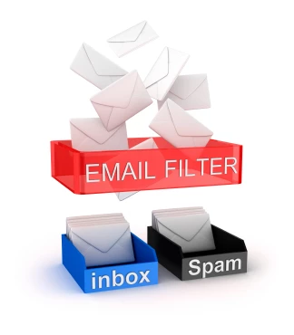

Spam Filter & Malicious URL Detector
Presented by :- Team Dragonite
Khushil Modi (015923115)
Sarjak Patel(015945046)
Nevil Shah(015964975)

Slide 2
What is Spam & Malicious URL Filter?
A spam filter is a program that is used to detect unsolicited and unwanted email and prevent those messages from getting to a user's inbox.
Malicious websites are one of the most common cybersecurity threats
We have created a filter model which will detect if a link is malicious or safe so that users don’t get victim of phishing attacks.

Slide 3
Features :
Spam Filter :- A spam filter is a program that is used to detect unsolicited and unwanted email and prevent those messages from getting to a user's inbox. If user enters a text message , Spam Filter will detect if the message is spam or not.
Malicious Link detector :- Malicious URL or link is a link created with the purpose of promoting scams, attacks, and frauds. If user enters a link in the text-box, Spam filter will notify as output if the link is malicious or not.

Slide 4
Feature Engineering
Spam Detection is a binary classification problem whose aim is to unsolicited , unwanted and virus-infected emails to prevent spam messages from creeping into the user’s inbox.
Examples :-
Spam messages :-
1)Free 1 week holiday trip to Vegas
2) Congratulations.You are eligible to receive a free COVID vaccine. To Confirm, click on the below again.

Slide 5
Link Detection is the mechanism which will filter out phishing links and the good ones to save a person’s sensitive information like credit card details from getting stolen and misused for any malicious purposes.
Example :-
a)Good link:- https://www.facebook.com/login/
This is a good link asking for credentials to login into one’s Facebook Account and the entered credentials in this link will be safe as this page is authorized and secured by facebook.
b) Phished link:- faceboook.com/login/
The above link looks kind of similar to the actual link used by Facebook and the webpage will look similar to the real page , but this is a phishing link and the hackers can get the credentials entered in this vitriolic link and use them for their evil intentions.

Slide 6
Tools/Technologies
Front-End Development : Streamlit
Back-End Development : Python, Google Colab
Deployment : AWS EC2 instance
2 Kaggle Datasets (One for Spam Filter and other for Malicious URL detection)
Pickle : for Serializing ML algorithms and save serialized format in a file.

Slide 7
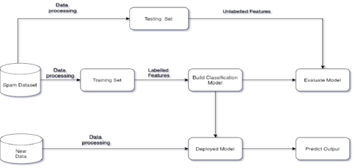
Workflow

Slide 8
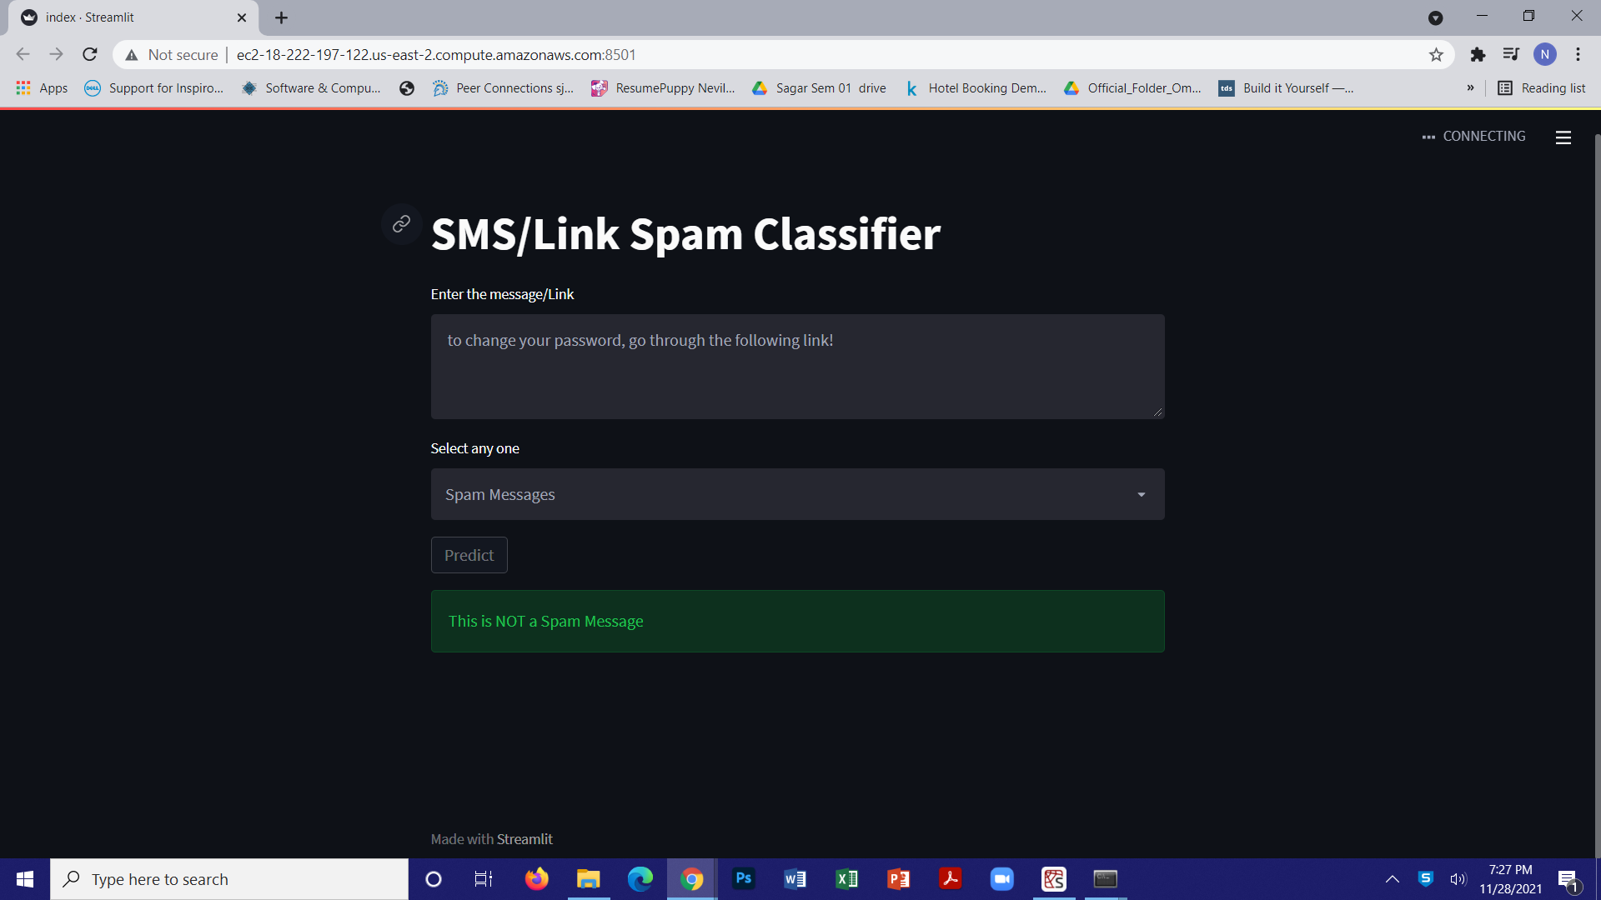
UI Design

Slide 9
Future Scope:
We can convert it into an extension of a web browser like chrome, firefox etc. so that user can directly detect whether the link is malicious or safe.

Slide 10
Thank You
Any Questions?

